Slide 1
QF205
Python programming and its application in tax calculator Group 2 Alvin Toh Yong Zhang Bae Jung Hyun Choi Seunghwa Kum Ji Weon Tsai Cheng-Jung

Slide 2
AGENDA
1. Objectives
2. Final Output - Demonstration
3. Application Flowchart
4. Code Implementation
5. Q & A

Slide 3
Objectives
1. Impact of corporate taxation can influence investment decisions
Corporate taxation is imperative in the financial investment decision - making process
In an attempt to alleviate a tax burden for a overseas subsidiary company to increase the company’s net income.
2. To accomodate the needs of changing financial institutions landscape
“Technology will turn information into a commodity, so an expectation on the finance function is that we’ll spend most of the time providing added value to the business”
Thriving in the Digital Economy: Four Reasons Why Finance Is Excited about the Future (Judy Cubiss, 2015)
Notes:
Give example on impact of corporate taxation can influence investment decisions; if we find the countries with low tax rate, tax burden; net income etc.
Thought of using python app.

Slide 4
Objective of the five tax calculation options
1. National Rate + Branch Rate
: Most countries apply different tax rates to foreign corporations, which tends to be the higher than that of domestic corporations
2. Minimum Tax Rate
: When the corporate net income < stipulated amount. The min tax rate is typically within a range of 0.3% to 0.4% of net income.
Notes:
Varies among different countries,
Only sets in if you net income doesn’t exceed certain threshold,
Give example on a company who earn less than 100,000, then the 0.3 and 0.4% will set in.

Slide 5
3. Progressive Income tax rate:
: Applies different tax rates to different ranges of corporate net income
4. Industry-specific tax rate
: Different tax rates are often applied to corporations operating in certain industries in order to incentivize or disincentivise
5. Top 10 countries with the least taxes to be paid in regardless of categories
: Showing us the 10 most attractive candidate
countries with the least taxes to be paid.
Notes:
4. give example like oil and gas. Saudi Arabia – category tax rate on oil related industries.
Every 4 payment sums will be linked to top 10 countries with the least taxes. I don’t discriminate from option 1 to option 4.

Slide 6
2. Output - Demonstration

Slide 7
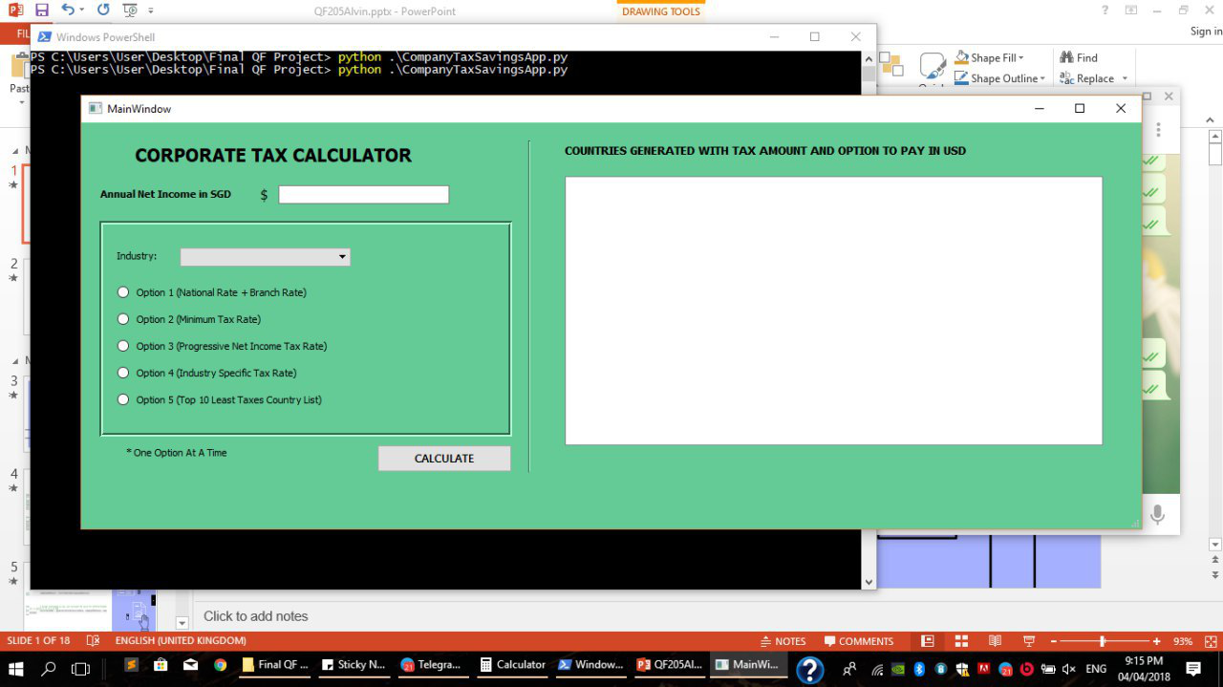
FINAL
OUTPUT

Slide 8
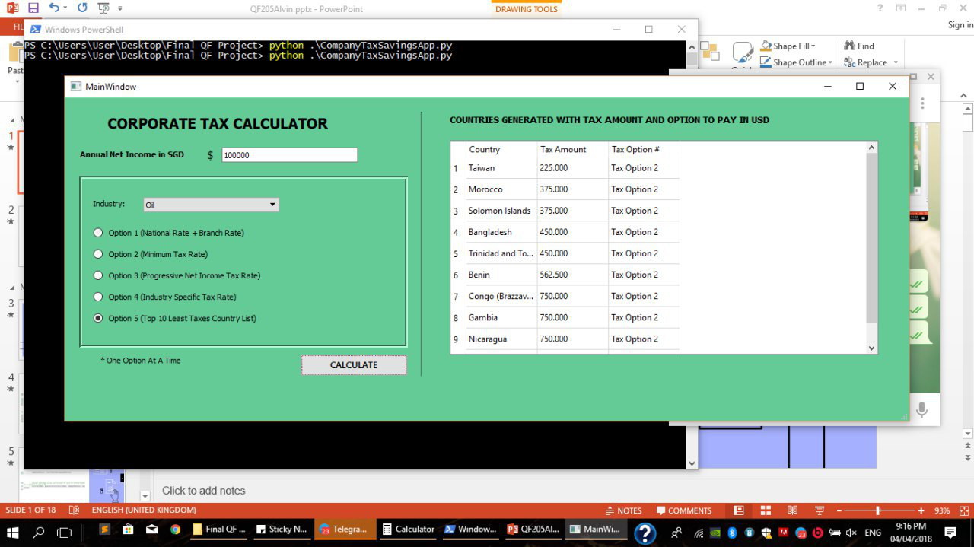
Possible Ideas to do with our App

Slide 9
<Taiwan, SGD 500,000>
Net Income
National Rate & Branch Rate
Tax
Net Income
Minimum Rate
Tax
USD
75,000
Subsidiary 1
0.3%
225
Subsidiary 2
75,000
0.3%
225
USD
375,000
Branch (20%)
+
National (20%)
Parent
Subsidiary 3
150,000
Split!
75,000
0.3%
225
Subsidiary 4
75,000
0.3%
225
Subsidiary 5
75,000
0.3%
225
Total Tax = 150,000
Total Tax = 1,125

Slide 10
3. Application FlowChart

Slide 11


APPLICATION FLOWCHART
Data Processing
Input
Convert Deloitte Report to countryTax.csv
Generate a categoryDict.csv with Category Name and 3 char category code
Input SGD Net Income
Input Category chosen from Dropdown list
Choose option 1 - 5

Slide 12


APPLICATION FLOWCHART
Tax Computation
Output
Convert SGD Net Income to USD
Generate a countryTax Dict with key as CountryName and value being a tuple with 4 values pegged to it
Generate a specified Country, Tax Amount for Option 1 to 4
Generate top 10 least taxes countries with Tax Amount and specified Option for Option 5

Slide 13
4. Code Implementation
Breaking down the codes

Slide 14
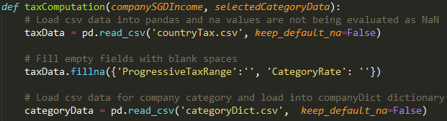
Step 1
Reads csv data from countryTax.csv using pandas and sets option to keep default_na which will not evaluate the values to Nan if it is empty
For computation purposes, fill up taxData DataFrame with empty strings for the columns ProgressiveTaxRange and CategoryRate
Reads csv data from countryDict using pandas with same option

Slide 15
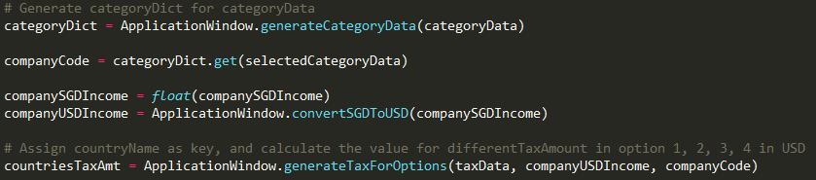
Step 2
Gets 3 char category code categoryData dataframe
Converts companySGDIncome input to companyUSDIncome for computation
Sets taxData dict, companyUSDIncome, and companyCode as input to taxComputation method to generate CountriesTaxAmt Dict

Slide 16
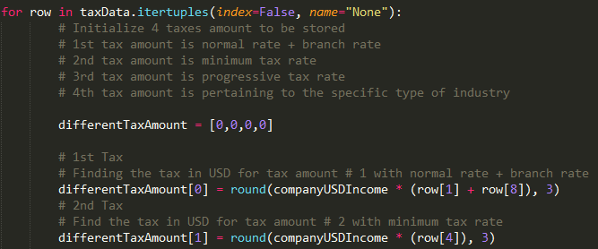
Step 3
Loop every row of taxData dataframe, and initialize tuple of size 4
Assign USDIncome * national + branch rate for option 1
Assign USDIncome * min tax rate for option 2

Slide 17
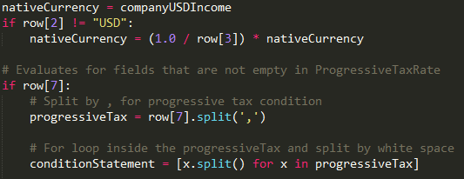
Step 4
Checks if nativeCurrency is USD, if not convert to nativeCurrency equivalent from USD
Checks if row[7] is a empty string, if not empty delimit it by “,” and further delimit by whitespace to separate the condition statement string out

Slide 18
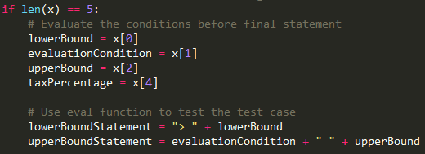
Step 5
Checks if length of condition statement is 5, if yes assign the various values to evaluate if income falls within the bracket. Length 5 also means it is not the last condition statement
If length condition is 4, it is the last condition statement and checks if income exceeds the bracket
Assign USDIncome * progressive tax rate for option 3

Slide 19
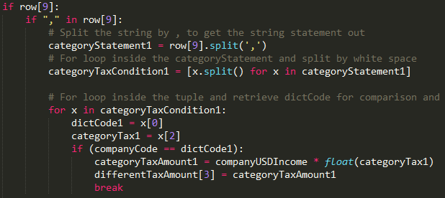
Step 6
Checks if categoryString field is present, delimit it by “,” and checks if it is equal to company specified category
If company specified category is equal to country category tax rate, assign USDIncome * category tax rate for option 4

Slide 20
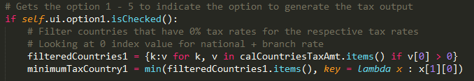
Step 7
After returning countriesTaxAmt Dict, filter out 0 values for each of the Option 1 – 4 selected
Uses Python min function to get the minimum taxAmount after looping through list
For Option 5, calculate min amount for each country first and sort the output list
Only takes the first 10 countries which has the least tax amount

Slide 21
QUIZ!

Slide 22
Given the need to store the progressive tax rate for
countries in csv,
how would some of you store the progressive tax rate in an easily readable format for Python to read and compute the data in?

Slide 23
Our Answer:
0 <= 2000000 == 0.000,
2000000 <= 8000000 == 0.050,
> 8000000 == 0.150

Slide 24

THANKS!
Any questions?

